Slide 1
Estilo Nórdico o Escandinavo
Detalles y Acabados
Natalia Chinchilla H.

Slide 2
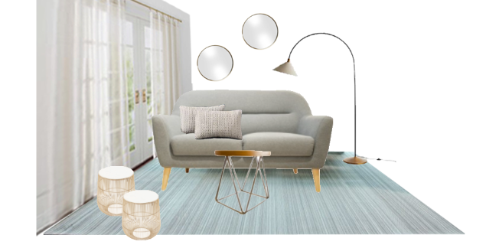

Slide 3
Acabado | Proveedor | Precio
Sofa Rusi | Altea | $469
Mesa de centro | Altea | $215
2 Mesas de lado | Altea | $236
Almohadones | Crate and Barrel | $120
Lampara de piso | Crate and Barrel | $199
Cortinas | Crate and Barrel | $69.95
Alfombra | Atmosphere Home | $207
Espejos | KARE | $998
Costo Total |  | $2513.95

